Slide 1
Durham County Youth Home
Volunteer Service Day
Saturday, October 6, 2012
Volunteer Students from:
Duke University
North Carolina Central University
University of North Carolina at Chapel Hill

Slide 2
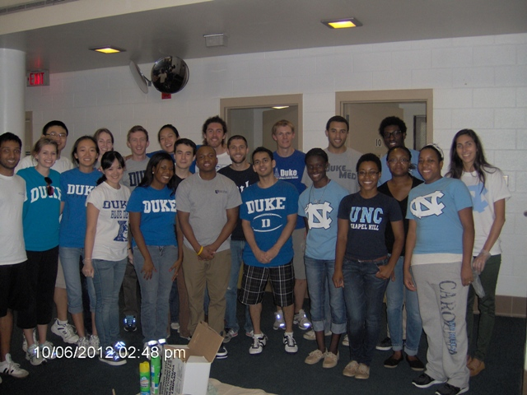
Volunteer Service day
Group photo of all volunteers assigned to Youth Home.
SMILE!

Slide 3
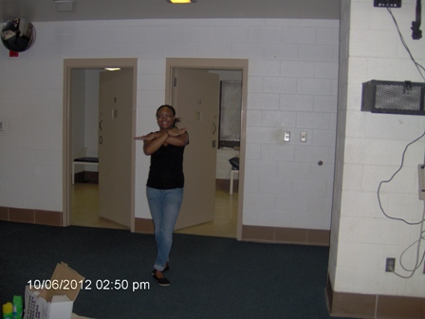
Representing>>>
North Carolina Central University

Slide 4
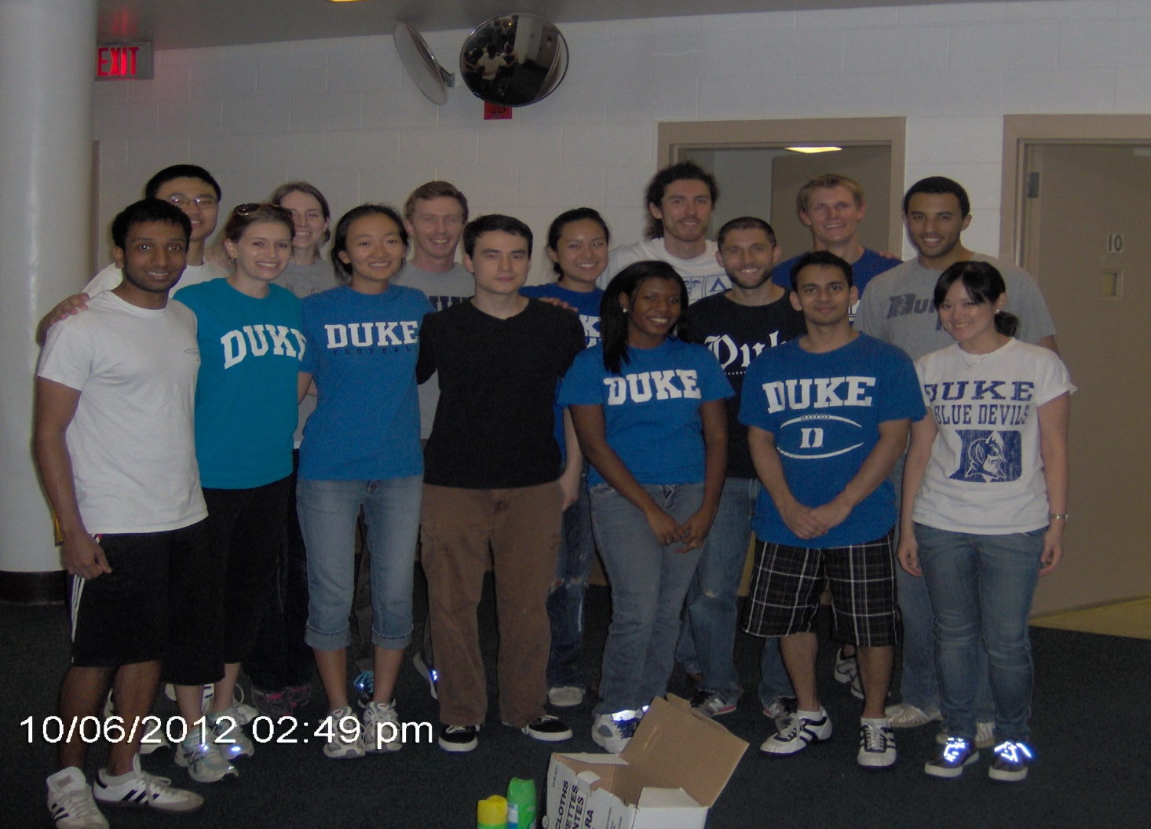
Representing>>>
Duke University

Slide 5
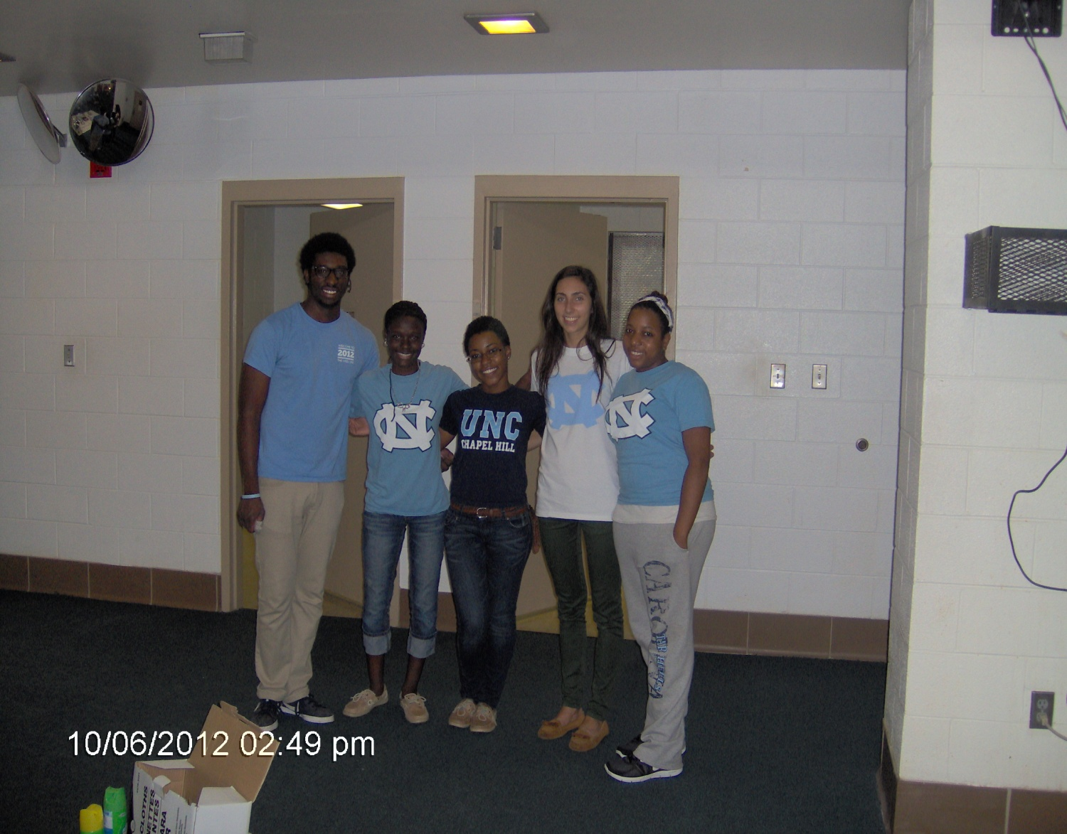
Representing>>>
University of North Carolina at
Chapel Hill

Slide 6
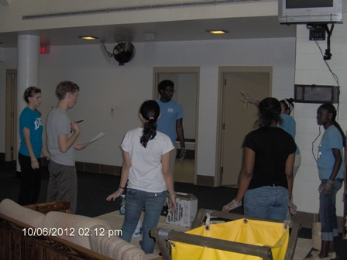
Working together … to get it done!
Volunteers making decisions about tasks to be done

Slide 7
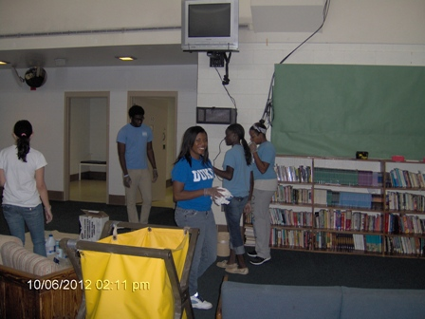
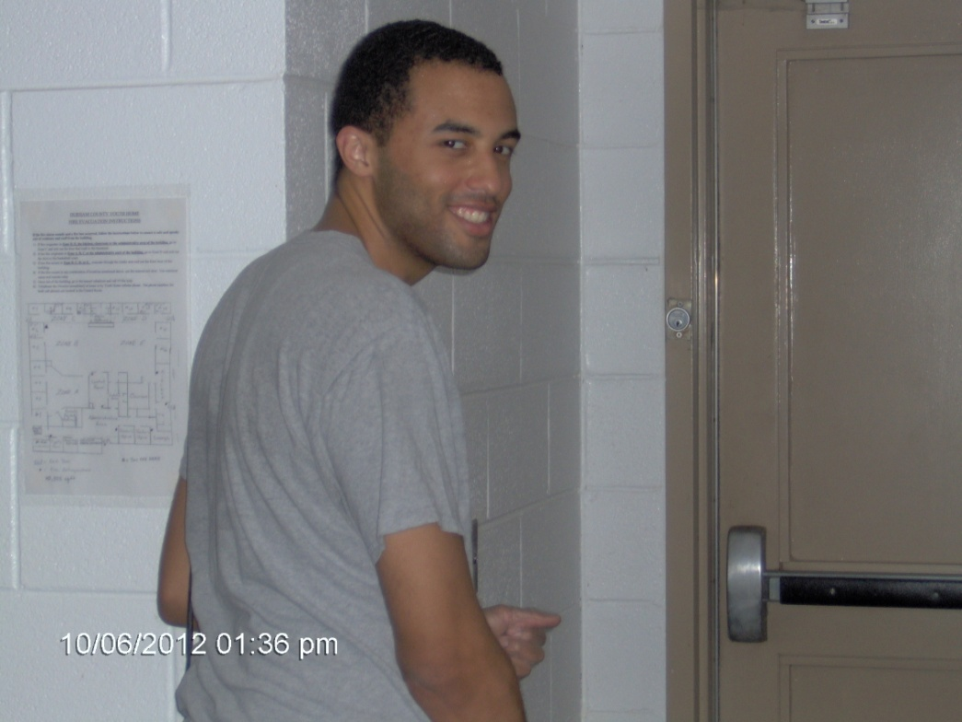
Enjoying the work

Slide 8
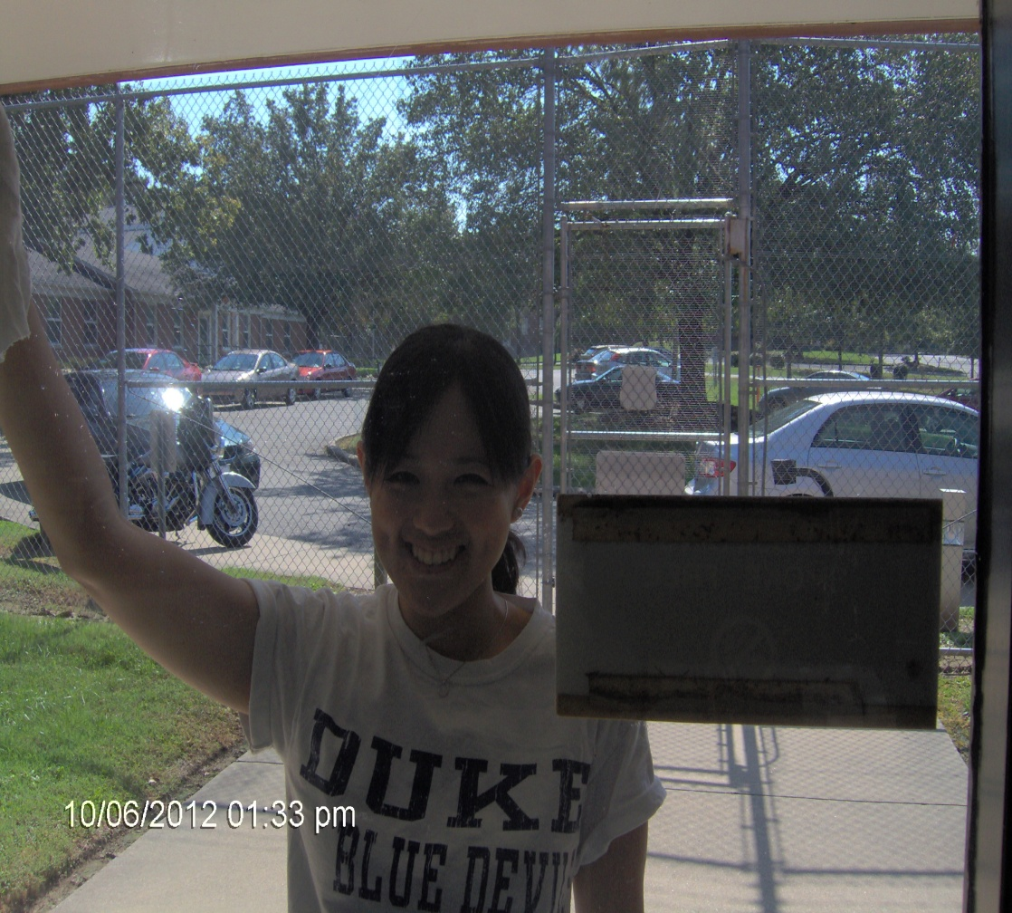
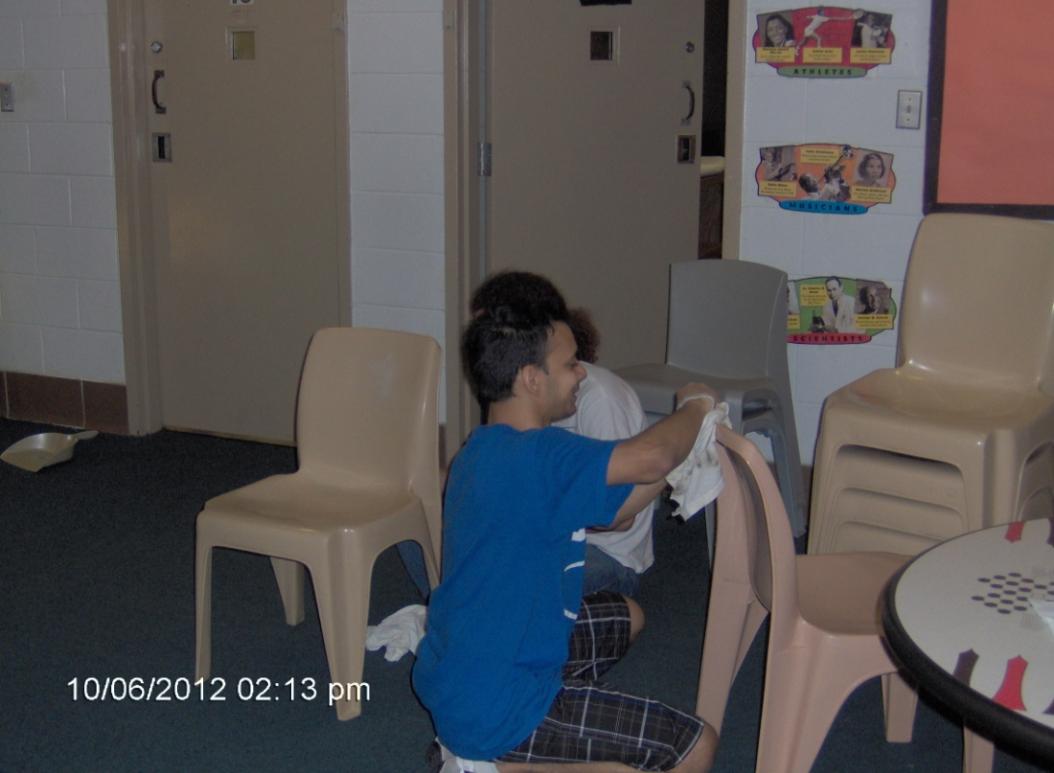
HAPPY ARE THE HELPERS

Slide 9
