Slide 1


2017 Resident Survey
Durham County, North Carolina
Presented by
February 2018

Slide 2
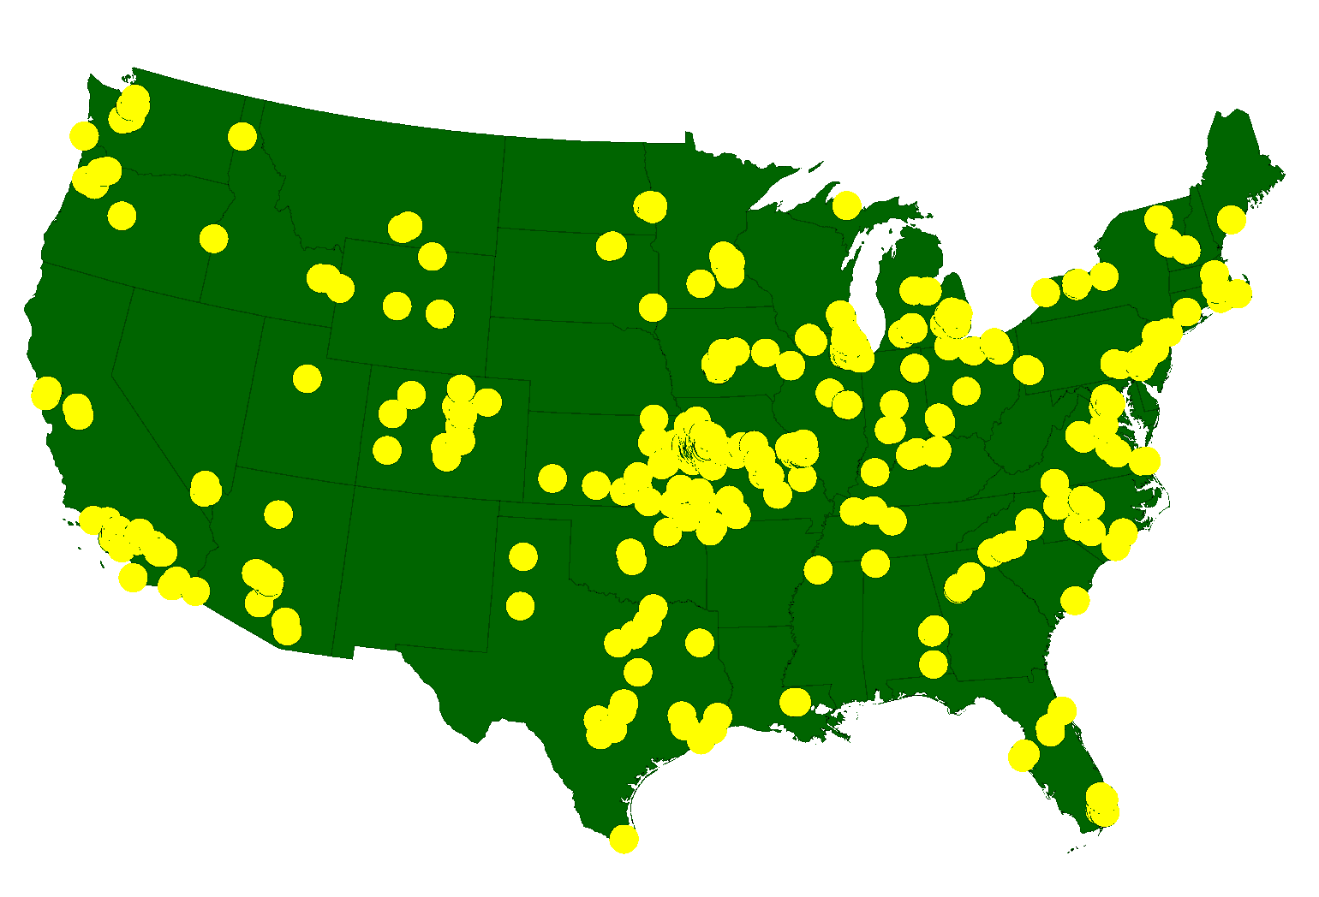
ETC Institute
A National Leader in Market Research
for Local Governmental Organizations
…helping Town and county governments gather and use survey data to enhance organizational performance for more than 30 years
More than 2,150,000 Persons Surveyed Since 2007
for more than 900 cities in 49 States

Slide 3
Agenda
Purpose and Methodology
Bottom Line Upfront
Major Findings
2
Summary
Questions

Slide 4
Purpose
To objectively assess citizen satisfaction with the delivery of County services
To help determine priorities for the community
To measure trends from previous surveys
To compare the County’s performance with other large communities across the U.S.
4

Slide 5
Methodology
Survey Description
  seven-page survey administered in December; included many of the same questions from previous surveys
Method of Administration
  by mail, online and phone to randomly selected households
  each survey took approximately 15-20 minutes to complete
Sample size:
  total of 609 completed surveys
  406 surveys from City residents, 203 from unincorporated County residents
  demographics of survey respondents accurately reflects the actual population of the County
Confidence level: 95%
Margin of error: +/- 4.0% overall

Slide 6
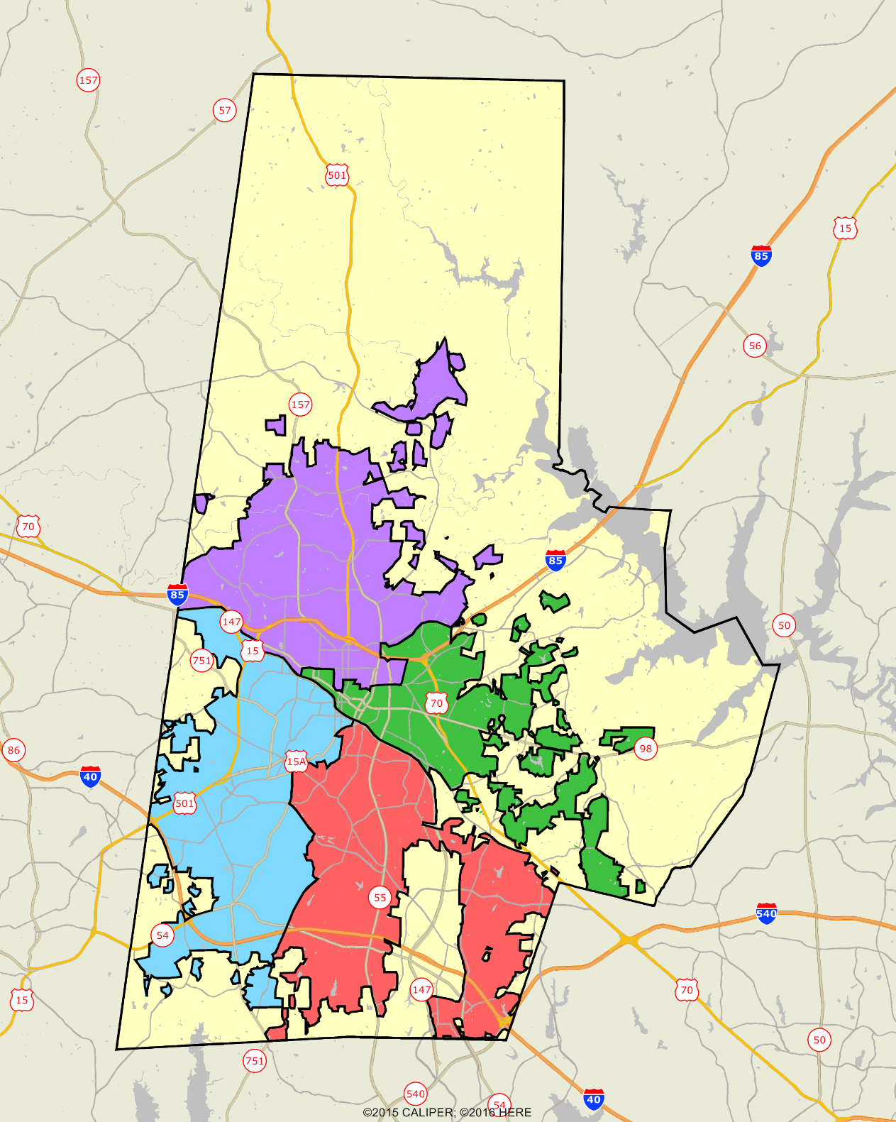
Durham County
2017 Resident Survey
PAC 2
PAC 3
PAC 4
PAC 1 &
PAC 5

Slide 7
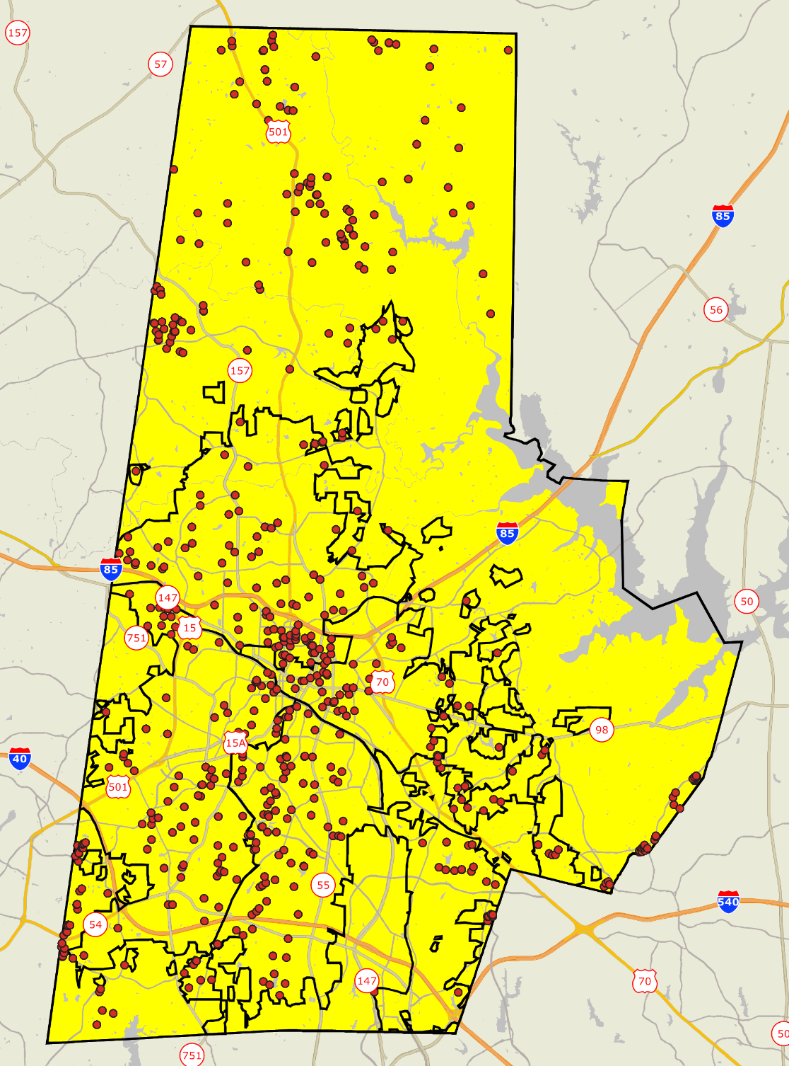
Location of Survey
Respondents
Durham County
2017 Resident Survey
Good Representation throughout the County

Slide 8
Bottom Line Up Front
Residents Have a Positive Perception of the County
    81% rated the County as an excellent or good place to live; only 9% rated it as below average or poor
    76% are satisfied with the overall quality of life in their neighborhood; only 9% are dissatisfied
Durham County Rates Higher Than Other Large Communities in the Overall Quality of County Services
  The County rated 10% above the average for other large communities in the overall quality of services provided by the County
Durham County Rates Higher Than Other Large Communities in Providing Customer Service
  The County rated 20% above the average for other large communities in the overall quality of customer service from County employees

Slide 9
Bottom Line Up Front
Overall community priorities for improvement over the next 2 years:
  Public Schools
  Overall Maintenance of Streets
  Police Protection
  Ease of Travel within Durham
Overall County priorities for improvement over the next 2 years:
  Public Schools
  Services of Durham County Dept. of Social Services
  Public Health Services
  Sheriff Protection

Slide 10
Major Finding #1
Residents Have a Positive Perception of the County

Slide 11
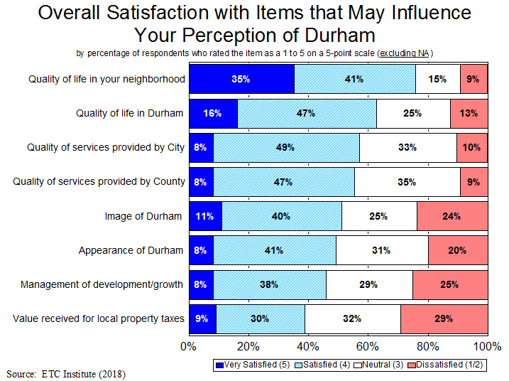
More Than a 6-1 Ratio of Residents Who Are Satisfied vs. Dissatisfied with the Overall Quality of Services Provided by the County (55% vs. 9%)
11

Slide 12
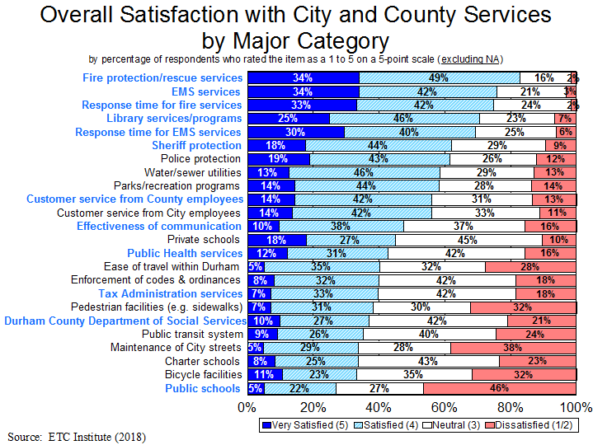
Most Services Get High Ratings. Public Schools and Transportation-related Issues (Street Maintenance, Pedestrian & Bicycle Facilities) Are the Only Areas with Significant Levels of Dissatisfaction.
12

Slide 13
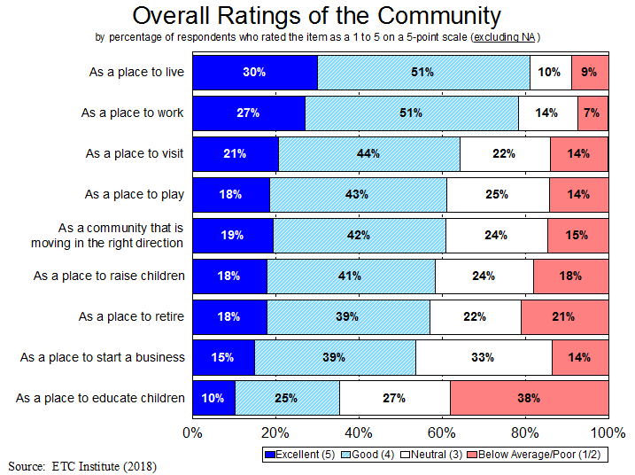
9-1 Ratio of Residents Who Feel the County Is an Excellent/Good Place to Live, Compared to Below Average/Poor (81% vs. 9%)
13

Slide 14
Major Finding #2
Residents in All Areas of the County Are Satisfied with the Overall Quality of County Services

Slide 15
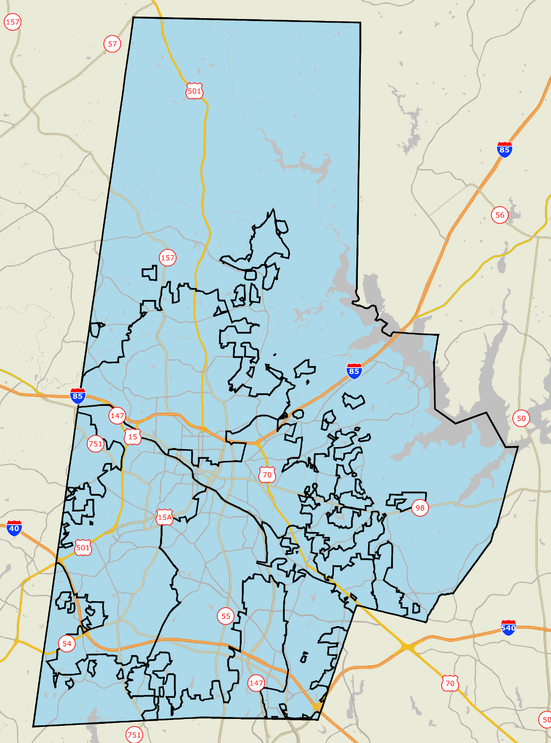


Satisfaction with Overall Quality of Services Provided by the County
All areas are in BLUE, which indicates that residents in all parts of the County are satisfied
Citizen Satisfaction
Mean rating on a 5-point scale
1.0-1.8 Very Dissatisfied
1.8-2.6 Dissatisfied
2.6-3.4 Neutral
3.4-4.2 Satisfied
4.2-5.0 Very Satisfied
No Response
PAC 2
PAC 3
PAC 1 &
PAC 5
PAC 4
ETC INSTITUTE

Slide 16
Rating Durham as a Place to Live
All areas are in BLUE, which indicates that residents in all parts of the County are satisfied
Citizen Satisfaction
Mean rating on a 5-point scale
1.0-1.8 Poor
1.8-2.6 Below Average
2.6-3.4 Neutral
3.4-4.2 Good
4.2-5.0 Excellent
No Response
PAC 2
PAC 3
PAC 1 &
PAC 5
PAC 4
ETC INSTITUTE

Slide 17
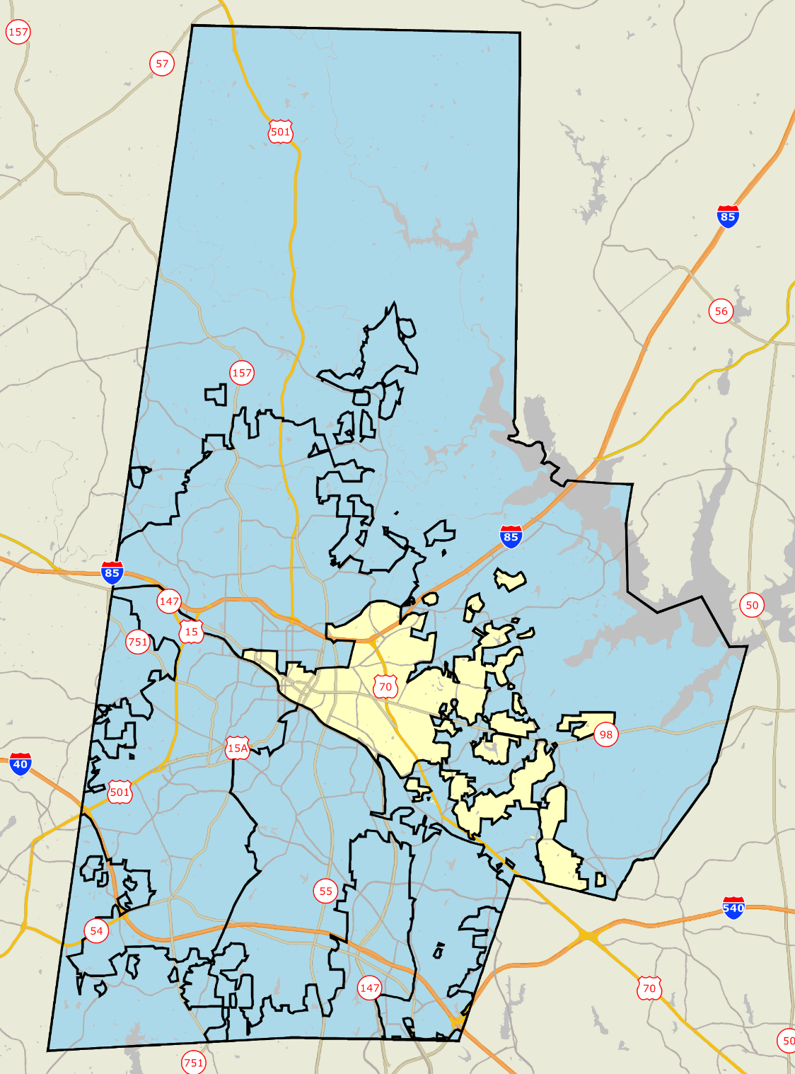
Rating Durham as a Community That Is Moving in the Right Direction
Most areas are in BLUE, which indicates that residents in most parts of the County are satisfied
Citizen Satisfaction
Mean rating on a 5-point scale
1.0-1.8 Poor
1.8-2.6 Below Average
2.6-3.4 Neutral
3.4-4.2 Good
4.2-5.0 Excellent
No Response
PAC 2
PAC 3
PAC 1 &
PAC 5
PAC 4
ETC INSTITUTE

Slide 18
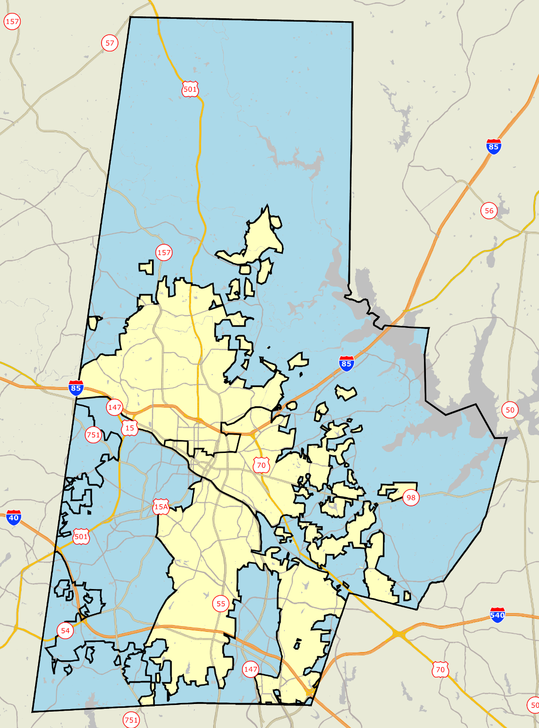
Feeling of Safety When Walking Alone in Your Neighborhood at Night
Overall, residents feel more safe in unincorporated County than in the City
Citizen Satisfaction
Mean rating on a 5-point scale
1.0-1.8 Very Unsafe
1.8-2.6 Unsafe
2.6-3.4 Neutral
3.4-4.2 Safe
4.2-5.0 Very Safe
No Response
PAC 2
PAC 3
PAC 1 &
PAC 5
PAC 4
ETC INSTITUTE

Slide 19
Satisfaction with Overall Quality of Sheriff Protection
All areas are in BLUE, which indicates that residents in all parts of the County are satisfied
Citizen Satisfaction
Mean rating on a 5-point scale
1.0-1.8 Very Dissatisfied
1.8-2.6 Dissatisfied
2.6-3.4 Neutral
3.4-4.2 Satisfied
4.2-5.0 Very Satisfied
No Response
PAC 2
PAC 3
PAC 1 &
PAC 5
PAC 4
ETC INSTITUTE

Slide 20
Satisfaction with Response Time for Fire Services
All areas are in BLUE, which indicates that residents in all parts of the County are satisfied
Citizen Satisfaction
Mean rating on a 5-point scale
1.0-1.8 Very Dissatisfied
1.8-2.6 Dissatisfied
2.6-3.4 Neutral
3.4-4.2 Satisfied
4.2-5.0 Very Satisfied
No Response
PAC 2
PAC 3
PAC 1 &
PAC 5
PAC 4
ETC INSTITUTE

Slide 21
Satisfaction with Response Time for EMS Services
All areas are in BLUE, which indicates that residents in all parts of the County are satisfied
Citizen Satisfaction
Mean rating on a 5-point scale
1.0-1.8 Very Dissatisfied
1.8-2.6 Dissatisfied
2.6-3.4 Neutral
3.4-4.2 Satisfied
4.2-5.0 Very Satisfied
No Response
PAC 2
PAC 3
PAC 1 &
PAC 5
PAC 4
ETC INSTITUTE

Slide 22
Major Finding #3
Satisfaction Ratings for Durham County Are Generally Higher Than Other Large Communities

Slide 23
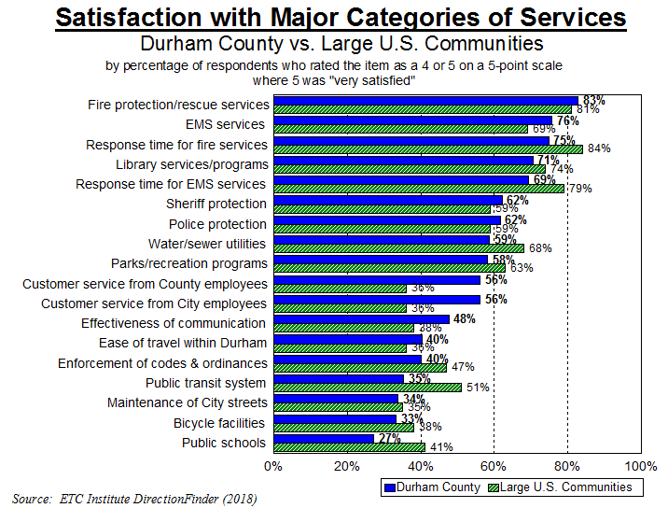
Significantly Higher: Significantly Lower:

Slide 24
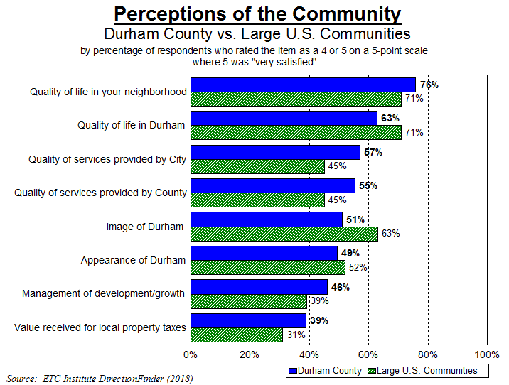
Significantly Higher: Significantly Lower:

Slide 25
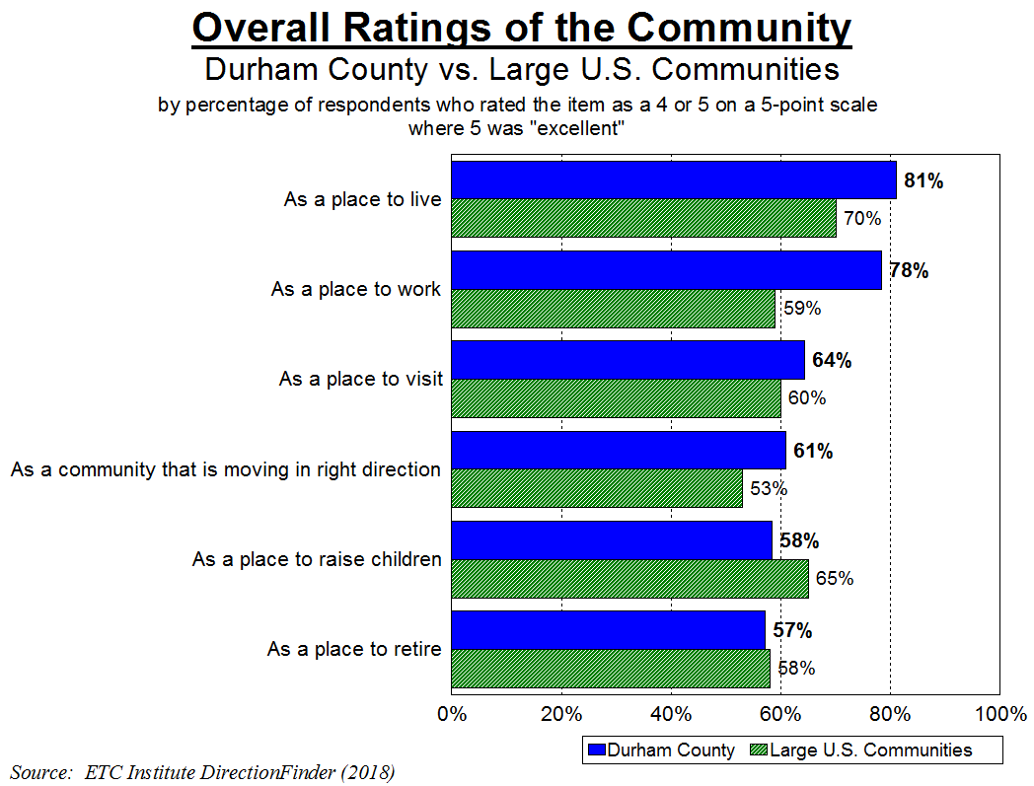
Significantly Higher: Significantly Lower:

Slide 26
Major Finding #4
Trend Analysis

Slide 27
Trends Analysis
2016 to 2017
Notable Increases in Satisfaction Since 2016
Yard waste collection services
Neighborhood has convenient outdoor places to run, walk, bike & exercise
Value received for local property taxes
County efforts to keep residents informed
Notable Decreases in Satisfaction Since 2016
Resolution to issue/concern
Accuracy of information given
Durham as a place to educate children
Encouraging community involvement in education-related decision making
Ease of travel within Durham

Slide 28
Major Finding #5
Top Priorities for Investment

Slide 29
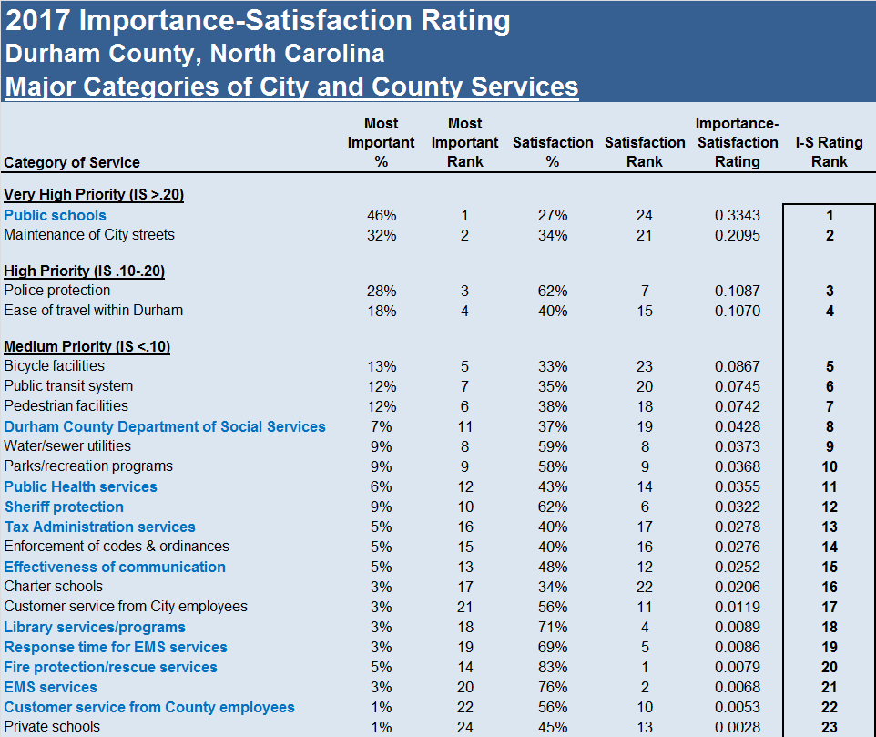
Overall Community Priorities:
29

Slide 30
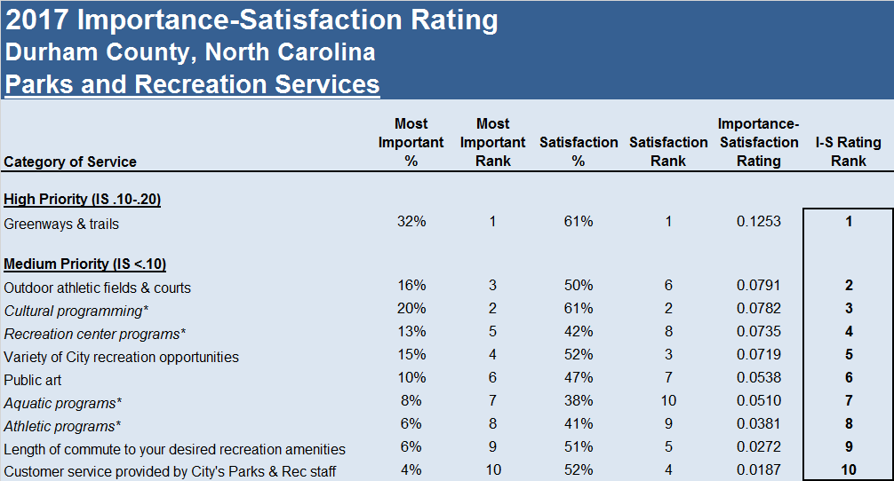
Parks and Recreation Priorities:
30

Slide 31
Other Findings

Slide 32
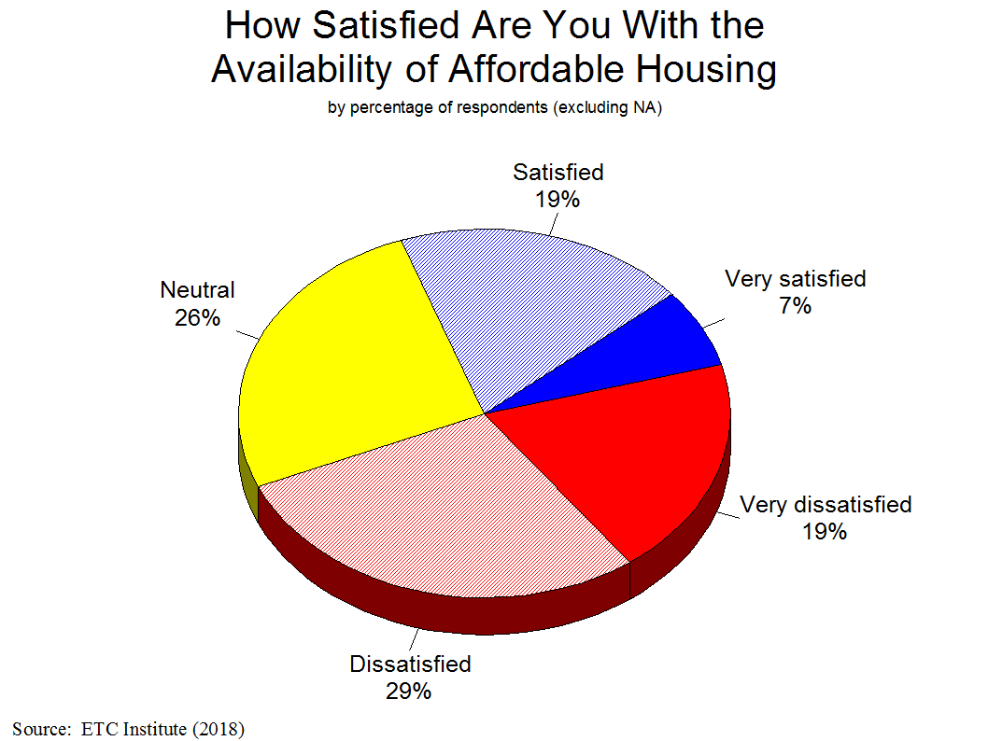

Slide 33
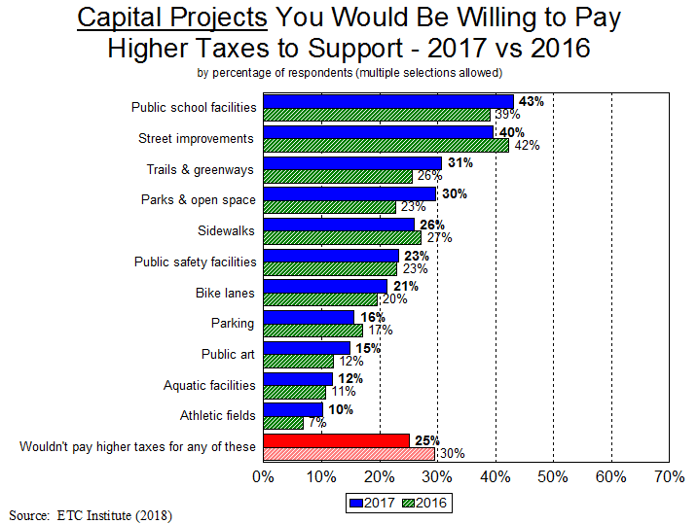

Slide 34
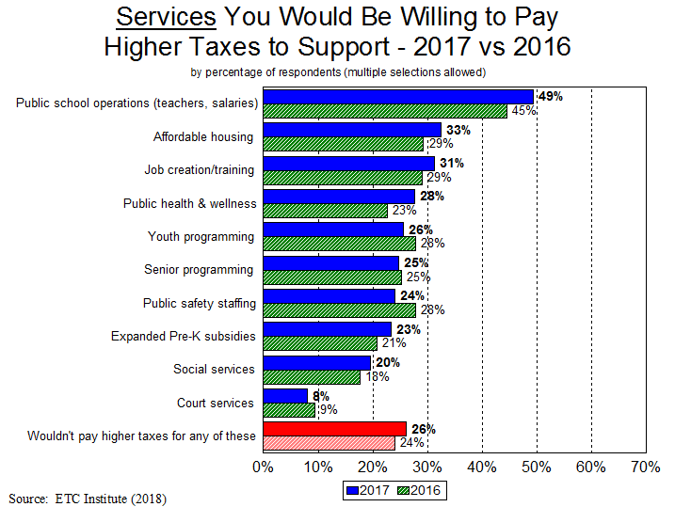

Slide 35
Summary
Residents Have a Positive Perception of the County
    81% rated the County as an excellent or good place to live; only 9% rated it as below average or poor
    76% are satisfied with the overall quality of life in their neighborhood; only 9% are dissatisfied
Durham County Rates Higher Than Other Large Communities in the Overall Quality of County Services
  The County rated 10% above the average for other large communities in the overall quality of services provided by the County
Durham County Rates Higher Than Other Large Communities in Providing Customer Service
  The County rated 20% above the average for other large communities in the overall quality of customer service from County employees

Slide 36
Summary
Overall community priorities for improvement over the next 2 years:
  Public Schools
  Overall Maintenance of Streets
  Police Protection
  Ease of Travel within Durham
Overall County priorities for improvement over the next 2 years:
  Public Schools
  Services of Durham County Dept. of Social Services
  Public Health Services
  Sheriff Protection

Slide 37
Questions?
THANK YOU!!

